Slide 1
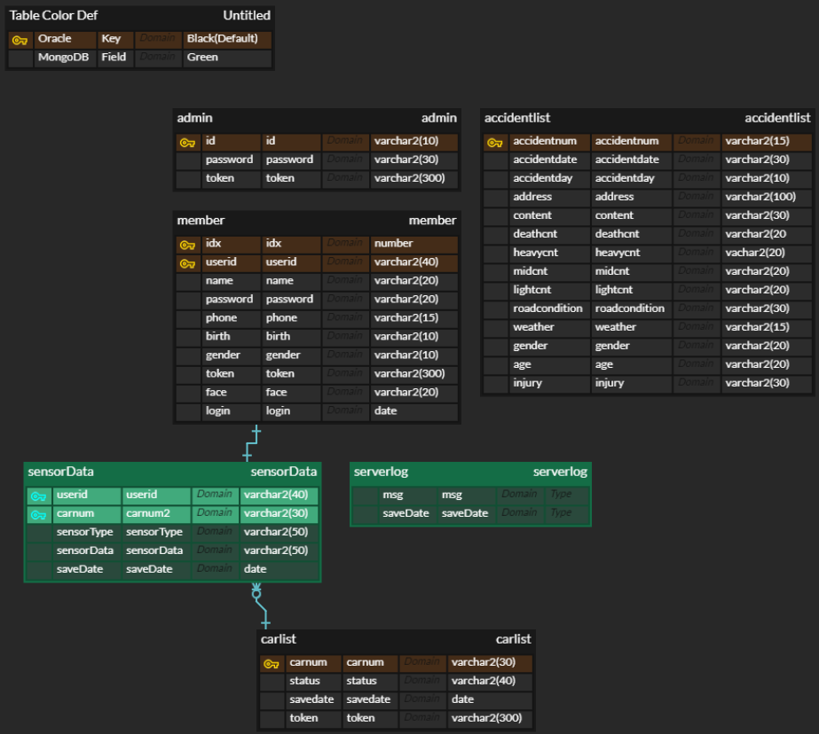
발표용 ERD

Slide 2
발표용 ERD without 설명컬럼
Headquarter
PK | userID
 | userName
 | userPwd
 | userEmail
 | userPhone
 | userRegDate
 | companyName
 | companyAddress
Inventory
PK | inventoryID
 | inventoryPayment
 | inventoryPurchaseDate
 | inventoryIngredientQuantity
Chain
PK | chainID
 | chainName
 | chainAddress
 | chainRegDate
FK | userID
InventoryDetail
PK | inventoryDetailID
 | inventoryInitialWeight
 | inventoryInitialQuantity
FK | ingredientID
FK | inventoryID
Ingredient
PK | ingredientID
 | ingredientCode
 | ingredientName
 | ingredientPrice
 | ingredientUnit
 | ingredientBrand
 | ingredientCategory
 | ingredientType
 | IngredientWeight
 | ingredientRegDate
 | ingredientPurchaseLink
 | ingredientPurchaseCount
 | ingredientImageName
ContainerDetail
PK | containerDetailID
 | containerFull
 | containerWarning
 | containerCurrentWeight
 | containerCurrentQuantity
FK | InventoryDetailID
Container
PK | containerID
 | containerSize
 | containerMaxWeight
FK | chainID
FK | containerDetailID

